Slide 1
Traditional card system
1
2
Card Processor
Card Issuer
Bank
Provides consumer
protection
The bank controls the card program and rates.
You, the customer, do not benefit from the revenue stream.

Slide 2
Since we are both a card program creation and card processing company, we can allow you to benefit from the income stream.

Slide 3
EndlessOne alternative
1
2
3
Card Issuer
Bank
You
Collects & distributes the fees.
You have more control over the program and revenue streams.
EndlessOne works with you to create the program and processes the transaction.
You receive between $2 to $10 per month for each card. No matter what location the card is used, you benefit.

Slide 4
Unique service offerings

Slide 5
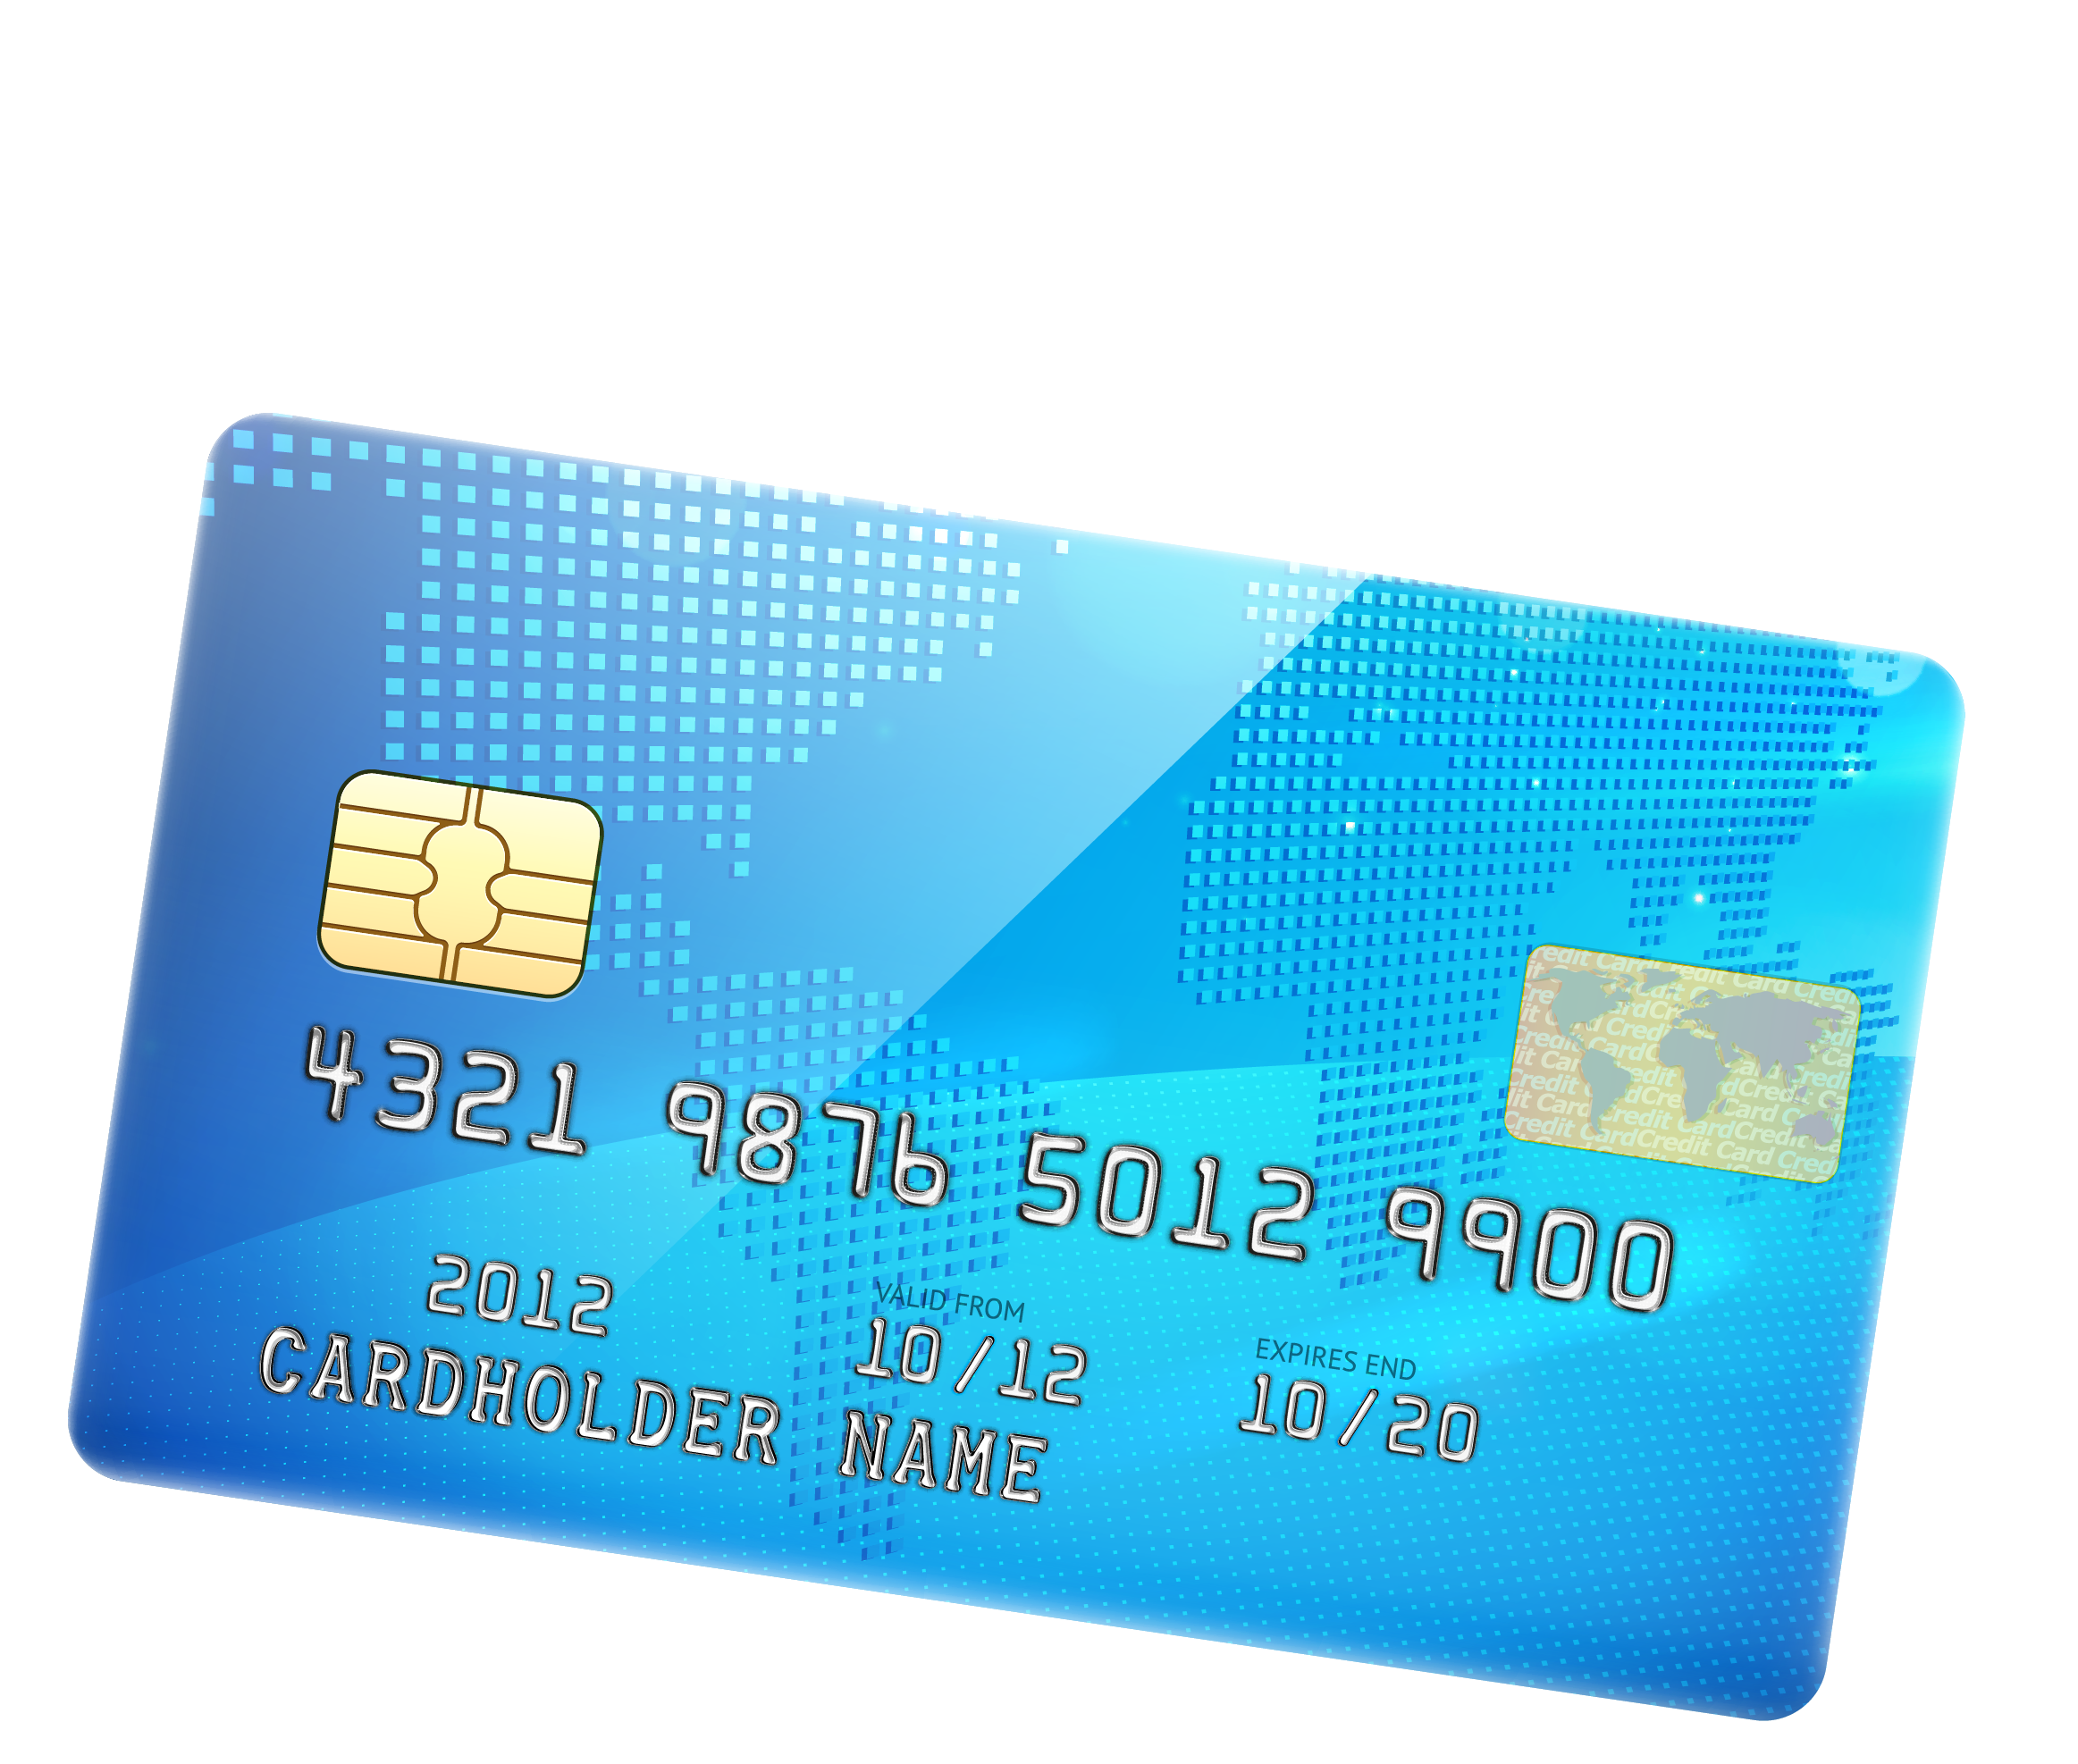
Key benefits
You create a new revenue stream
You customize and control the benefits for your customers
You
Having your own card increases your brand awareness
Reduce your payroll costs…and employees do not need a bank account to benefit

Slide 6
Security
Visa and MasterCard protect the money in your account
Our proprietary software suite is integrated into the card program

Slide 7
e-wallet system
Our e-wallet system offers cloud and phone-based access to your account:
Routing/checking number access and transfers
Automatic payment options
Simple integration with PayPal, MoneyGram, and Western Union
International remittance
HR support

Slide 8
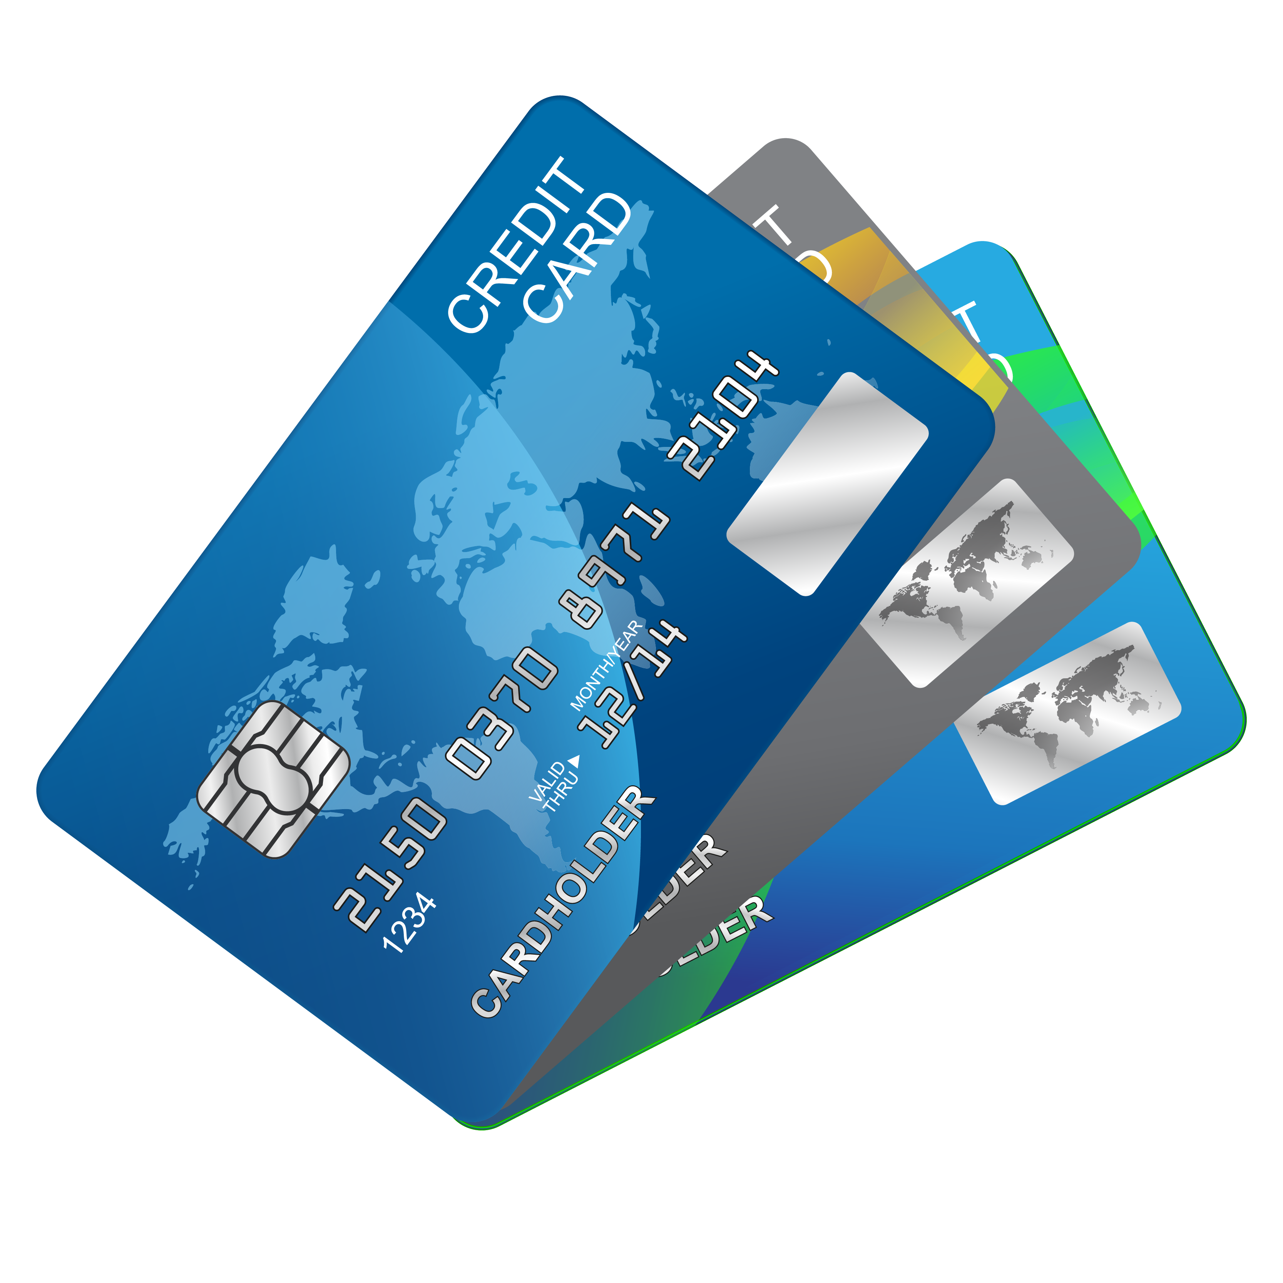
Companion card
We offer a ‘companion card program,’ so that your customers can give their family and love ones an additional linked card.
With the companion card you can send money to your family overseas instantly.

Slide 9
How to get started
Endless One makes starting easy - Each individual card program is tailored to your individual business needs. Our goal is to give all our customers options based on:
Number of end-users
The services they want to provide
The amount of revenue they want to generate
It takes about 2 months to roll out a new card program.
EndlessOne assists with MasterCard, the sponsor bank, fee negotiations, software implementation and training, and the launch of this exciting product.

