Slide 1
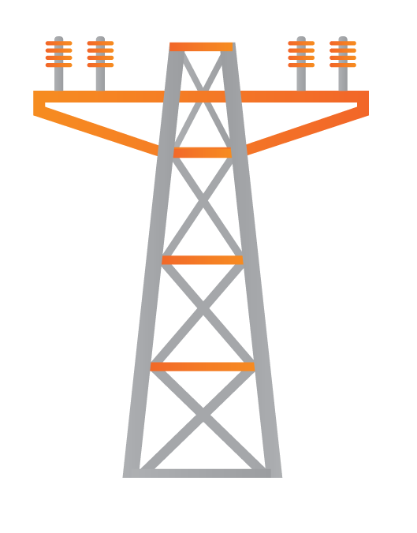
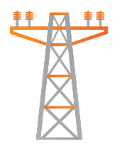
NUI MICRO-GRID Key steps to create a micro-grid
Today’s energy grid
Your home
Power grid
Homes and business rely on public power grids
www.transenergy.com

Slide 2
NUI MICRO-GRID Key steps to create a micro-grid
Step 1: Add solar array
Solar Power
Reduces costs
Mitigates brownouts during peak hours
Reduces standby genset use
www.transenergy.com

Slide 3
NUI MICRO-GRID Key steps to create a micro-grid
Step 2: Add storage
Stabilizes renewable energy generation
Mitigates brown-outs off-peak
Battery storage
www.transenergy.com

Slide 4
NUI MICRO-GRID Key steps to create a micro-grid
The micro-grid can support large loads and ‘green’ needs
Today’s energy grid
Electric car
Electric cars require 35 kWh per 100 miles
U.S. electric car owners pay $540/year over 15,000 miles compared to $2,135/year for gasoline
www.transenergy.com

Slide 5
NUI MICRO-GRID Key steps to create a micro-grid
Step 3: Add cloud-based management system
Cloud-based management
Handles predictive load balancing
Takes into account weather and power fluctuations both on and off the micro-grid
www.transenergy.com

Slide 6
NUI MICRO-GRID Key steps to create a micro-grid
Step 4: Connect everything to the NUI Frontier controller
Creates an intelligent micro-grid that you control right from your home
Receives energy from the grid, generators and renewable sources
www.transenergy.com

Slide 7
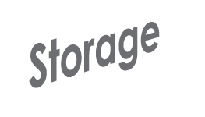
NUI MICRO-GRID Key steps to create a micro-grid
The NUI Frontier has 7 powerful modules for end-to-end control
With the NUI micro-grid, you can generate, consume, monitor and manage power independently from your home or business
Run your own energy from start to finish
www.transenergy.com

Slide 8
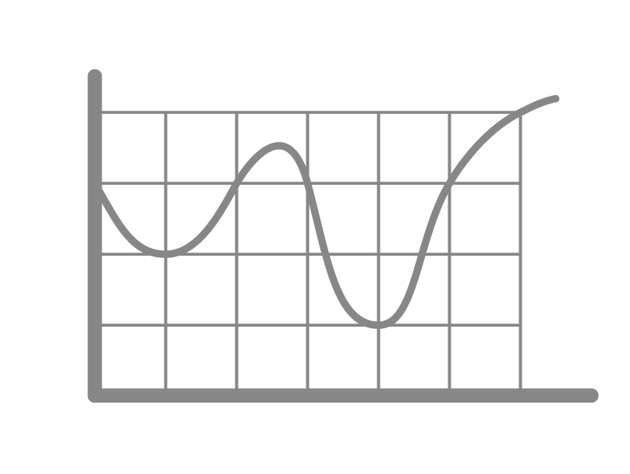
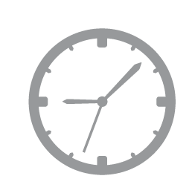
NUI MICRO-GRID Effective use of weather forecasting
Weather
Information
Demand Forecast
Scheduling
Generator Control
Demand forecast uses historical weather data to determine weather conditions for specific times month/day and expected and real-time PV output
Allows for minute-to-minute predictive control, time of usage differentials, and battery and storage control
www.transenergy.com

