Slide 2
The forces of change
All-Powerful Consumer
Globalization
Internet & Technology

Slide 3
Our brave new…
High-tech,
high-touch world

Slide 4
The Power Shift
Retail’s waves
Wave 1
Wave 2
Wave 3
Wave 4
Producer Power
Marketing Power
Consumer Power
Technology Power
1850
1950
1980
2011

Slide 5
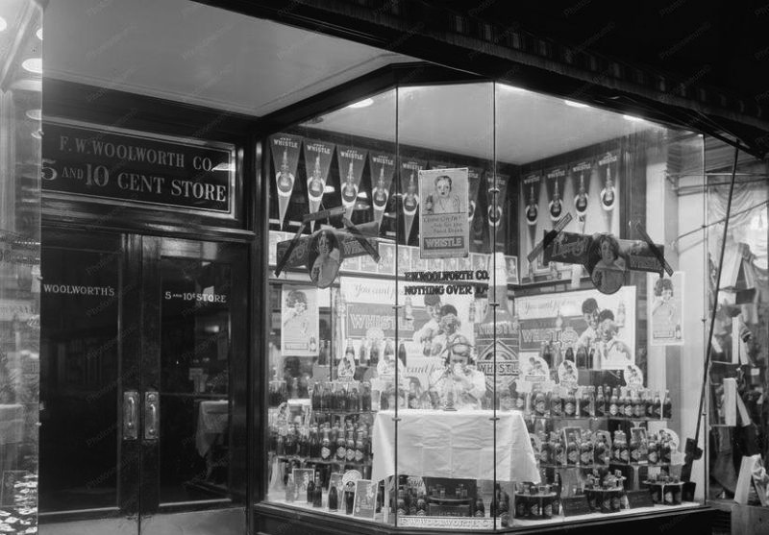
Wave 1: Producer Power
RETAIL MODELS
Regional department stores
Local general stores
Catalogs

Slide 6
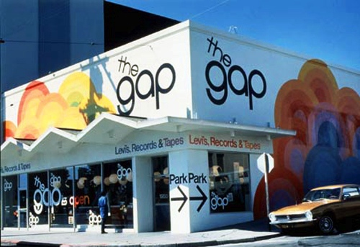
Wave 2: Marketing Power
RETAIL MODELS
National department stores
Big box
Specialty retail
Mass retail

Slide 7
The Power Shift
Retailing’s waves
Wave 3
Consumer Power
Wave 1
Wave 2
Wave 4
Producer Power
Marketing Power
Technology Power
1850
1950
1980
2011
Demand
Supply
Experience

Slide 8
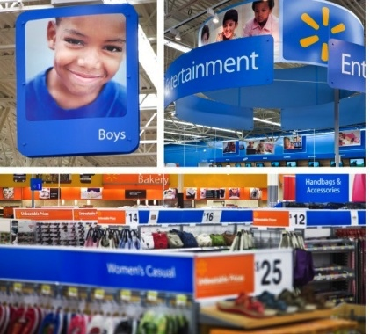
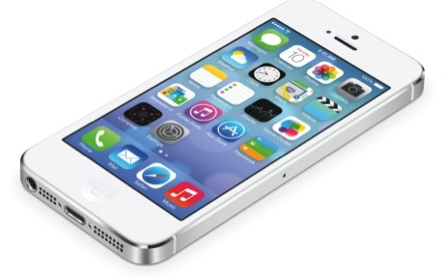
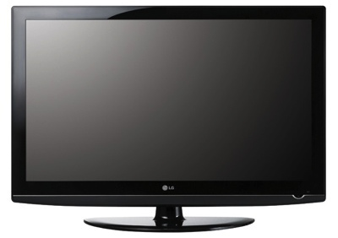
Consumers at the helm

Slide 9
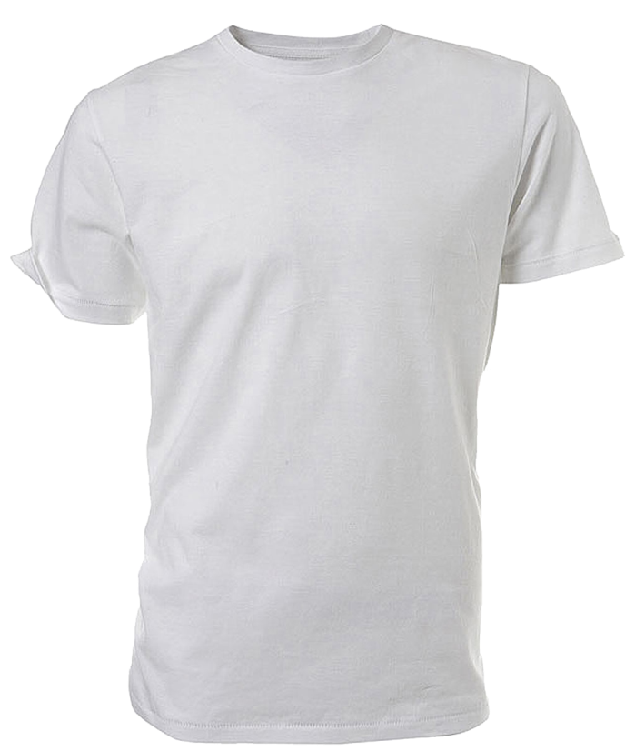
While costs decreased...
$4.90
$2.46
1989
2010

Slide 10
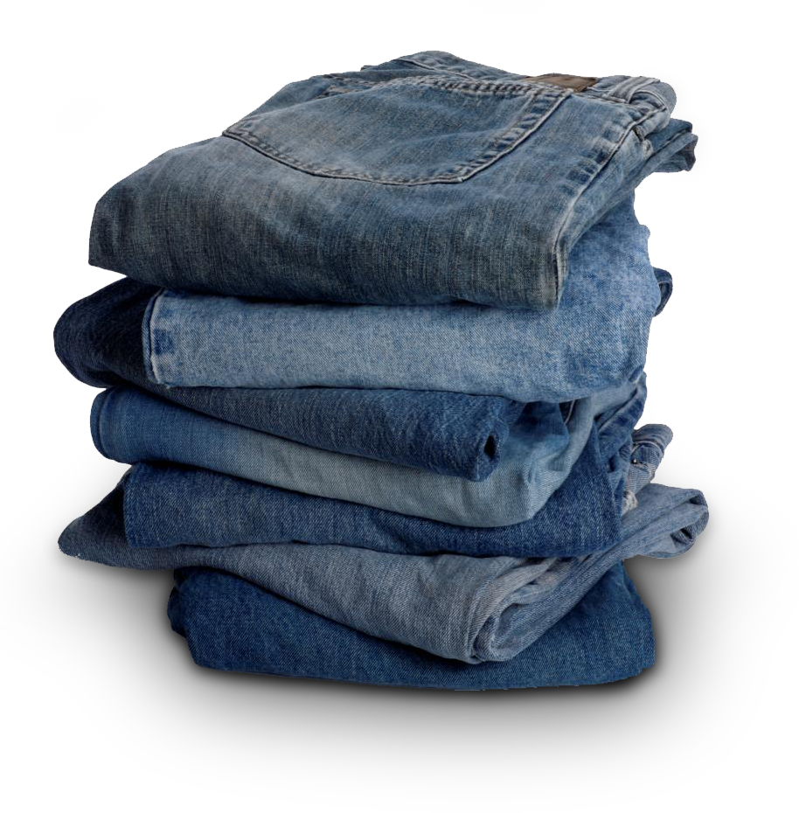
Amount of “stuff” increased
Number of blue jean brands
800
6
1980
2010
Notes:
IN 1980 THERE WERE LIKE 6 MAJOR BLUE JEAN BRANDS -= TODAY OVER 800
(SLIDE)

Slide 11
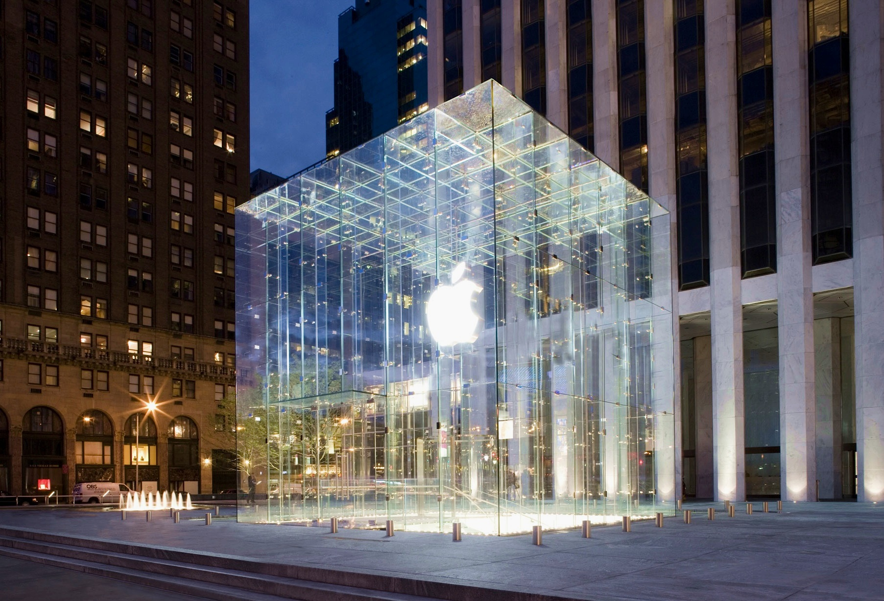
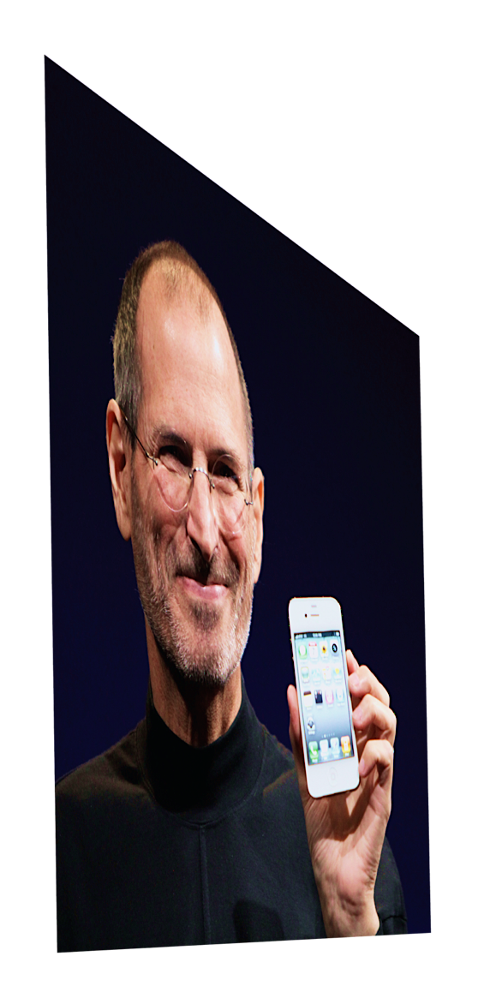
Wave 4: Technology Power
Convergence of art & science of retailing.
Jobsian Era

Slide 12
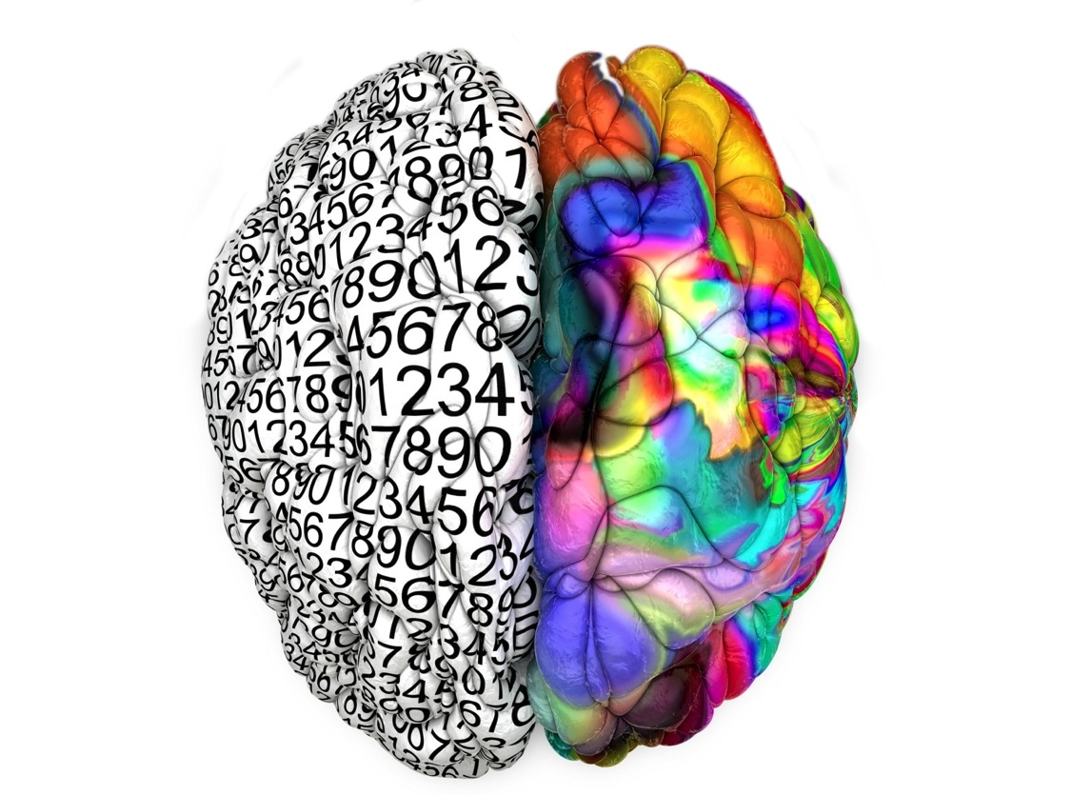
Left Brain
Right Brain
Convergence
Convergence
Incredible selection
Provide access
Cheaper prices
Incredible service
Artful design
Personal connection
Emotional engagement
Consumer friendly
COMPELLING EXPERIENCE

Slide 13
Today’s typical specialty retailer
15% of customers are offered cross-sell opportunities
60% of customers depart the store without engaging with the product
45% of customers do not engage with the sales associate
0% are offered cross-sell opportunities based on their personal history and search preferences

Slide 14
Notes:
WE FOUND THIS TO BE AN APT METAPHOR – AND THIS GUY WILL POP UP LATER WITH EVEN GREATER RELEVANCE
(SLIDE)

