Slide 1
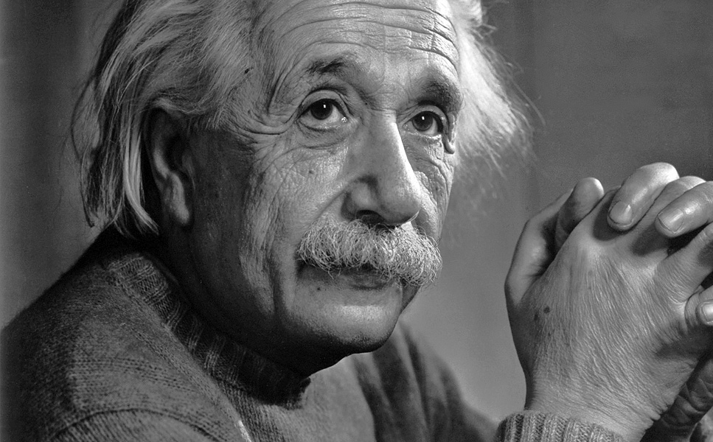
I fear the day that technology will surpass our human interaction.
The world will have a generation of idiots.

Slide 2
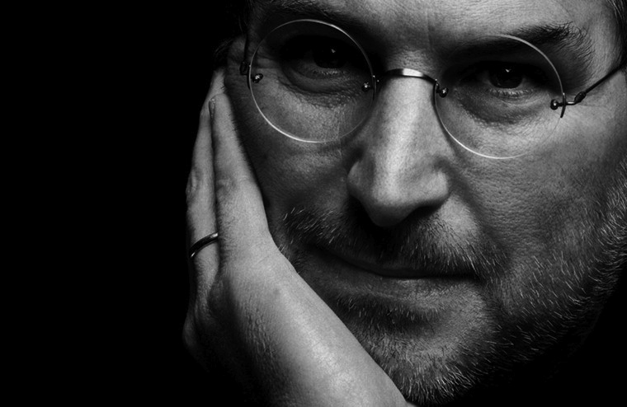
What incredible benefits can we give the customer?
Jobs didn’t say: ‘Let’s sit down with the engineers and figure out what awesome technology we have and then figure out how to market it.’

Slide 3
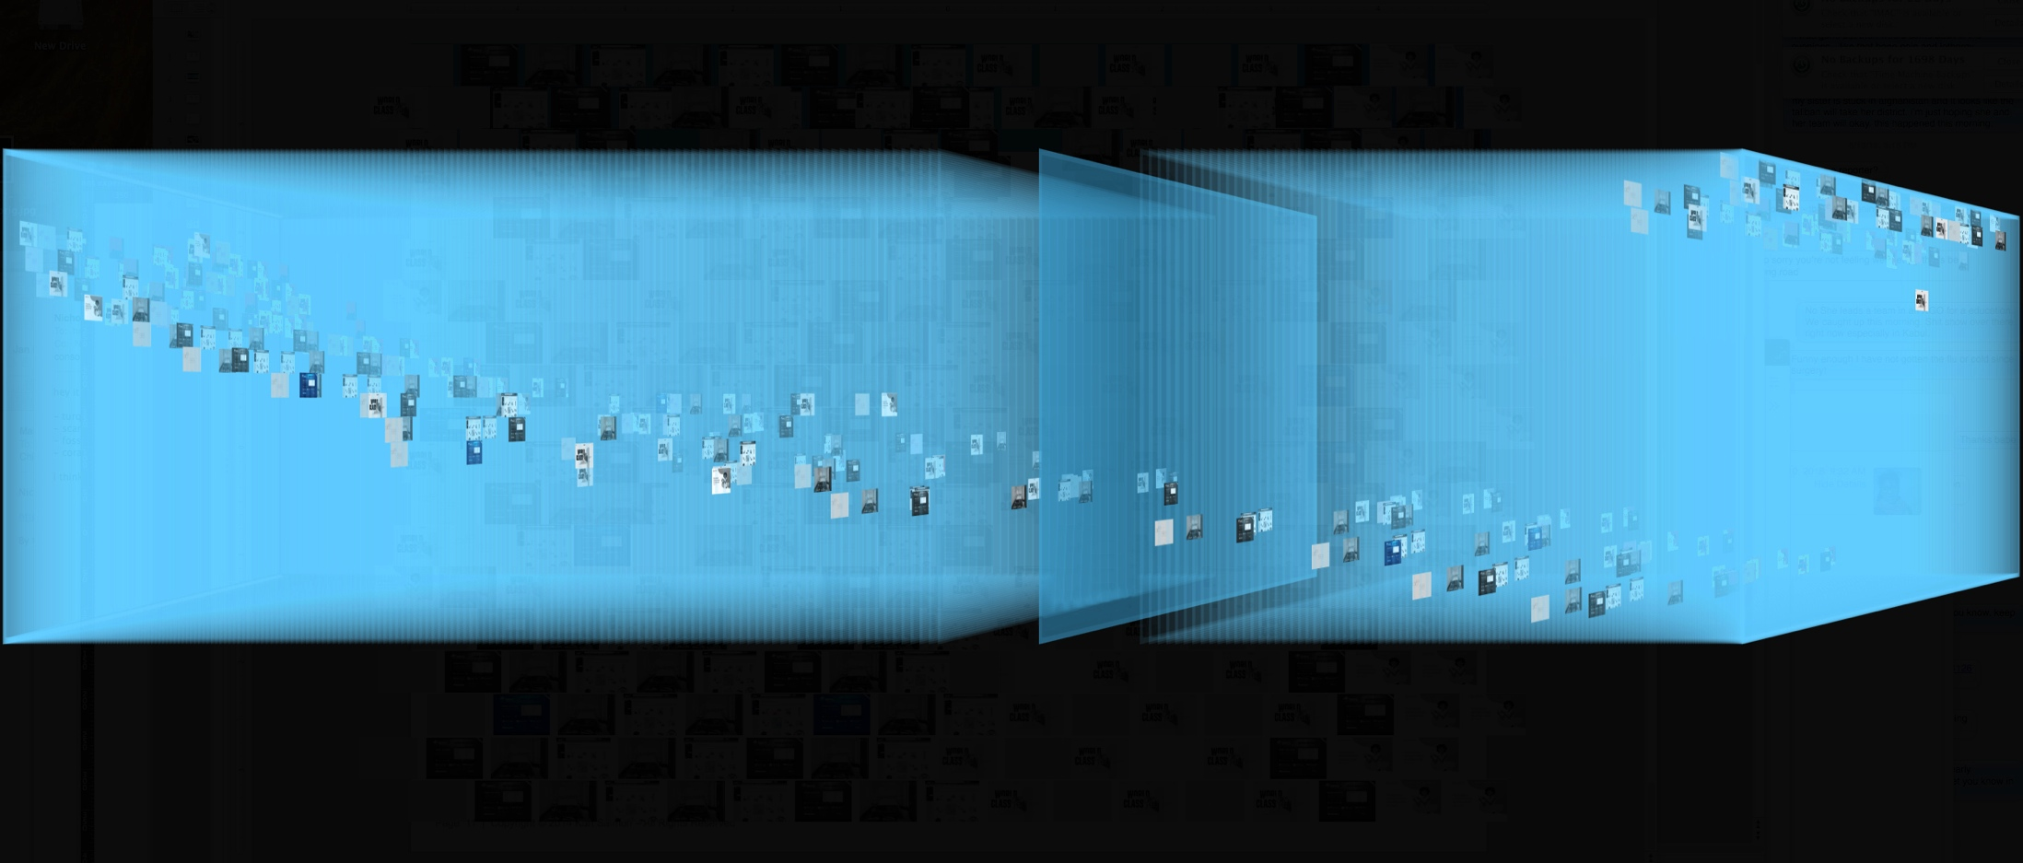
Information ‘overload’?
24,325,000,000
50 billion
Today there are
websites.
Notes:
2

Slide 4
So...
WHAT
DO THEY
WANT?
Notes:
SO WHAT DO THEY WANT?
WE’VE IDENTIFIED FIVE MAJOR SHIFTS IN WHAT CONSUMERS ARE SEEKING TODAY THEIR EXPECTATIONS ---AND I’M GOING TO ABBREVIATE THESE IN THE INTEREST OF TIME --- THERE’S A WHOLE CHAPTER IN THE BOOK ON THESE --- AND QUITE INTERESTING
(SLIDE)

Slide 5
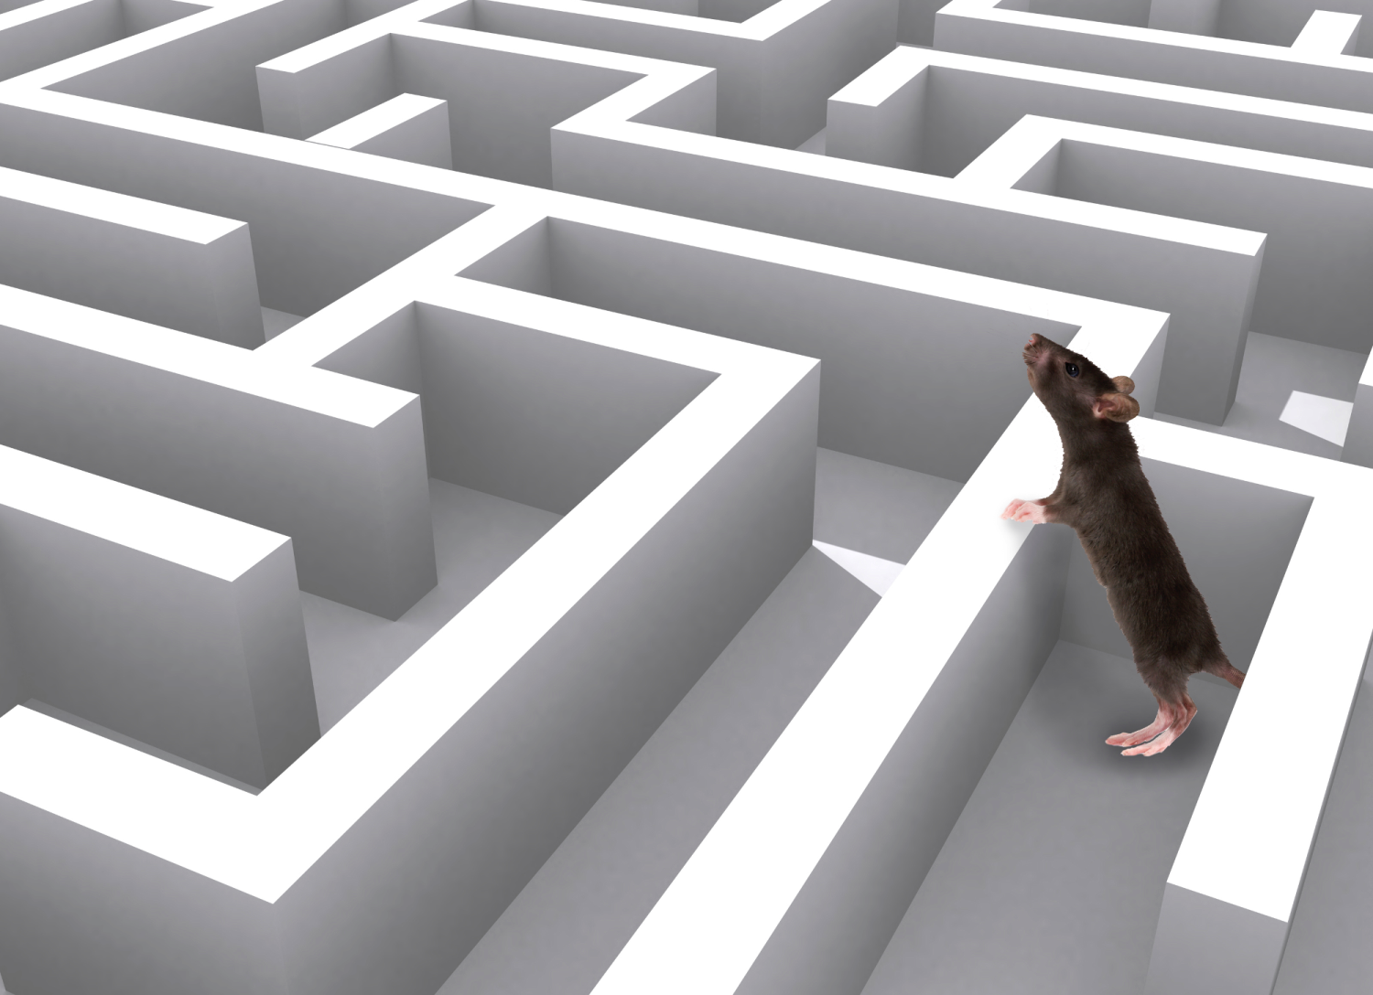
Notes:
WE FOUND THIS TO BE AN APT METAPHOR – AND THIS GUY WILL POP UP LATER WITH EVEN GREATER RELEVANCE
(SLIDE)

Slide 6
Information ‘overload’?
555,000 Libraries of Congress
15X
37,000 Libraries of Congress
Stored Information
’99 ’00 ’01 ’02 ’03 ’04 ’05 ’06 ’07 ’08 ’09 ’10 ’11 ’12 ‘13
Notes:
5

Slide 7
Bringing the FUTURE
TO LIFE

Slide 8
1
2
3
Actual shopping experience
Consumption or using
product or service
Neurological Connection is…
Pre-shopping anticipation
2
Notes:
--AND THE SUPERIOR EXPERIENCE IS HOLISTIC---MEANING THE DOPAMINE RUSH OCCURS 3 TIMES---
ONE--IN ANTICIPATION OF THE EXPERIENCE ---TWO –THE EXPERIENCE ITSELF AND FINALLY WHEN THE EXPERIENCE – PRODUCT OR SERVICE IS CONSUMED
FOR EXAMPLE ---THE ANTICIPATION RUSH --AT THE MERE MENTION OF ANY OF THESE BRANDS
AND MORE DOPAMINE DURING THE EXPERIENCE ITSELF --
AND THE FINAL DOPAMINE SURGE THE ACTUAL SATISFACTION OF ITS CONSUMPTION --- AND IT NEED NOT JUST BE FOOD --- IT CAN BE THE APPLE COMPUTER --- OR THE NEW DRESS FROM ZARA --- SPEAKING OF WHICH
(SLIDE)

Slide 9
50% of all brands and retailers will disappear

