Slide 1
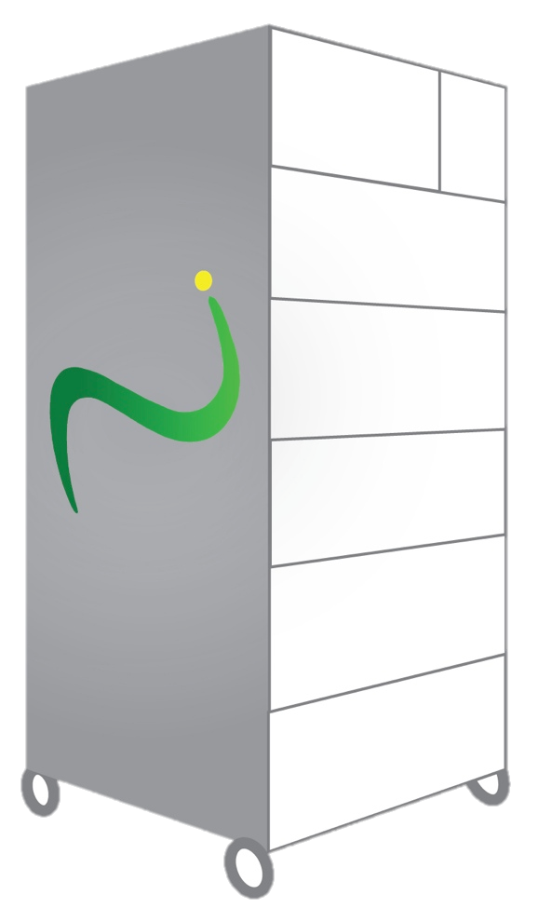
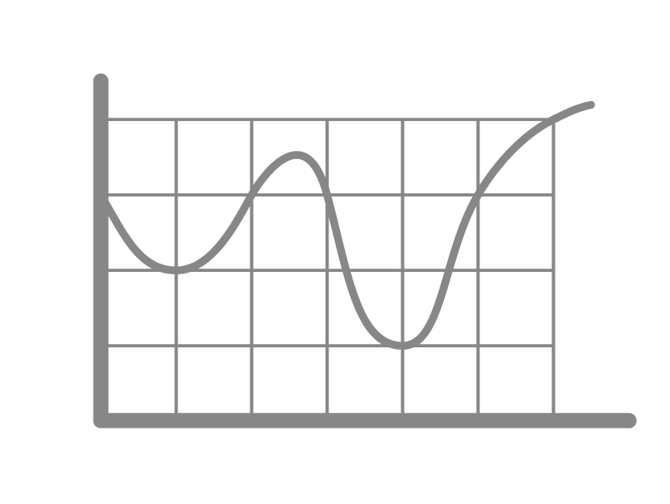
NUI MICRO-GRID Effective use of weather forecasting
Weather
Information
Demand Forecast
Scheduling
Generator Control
Demand forecast uses historical weather data to determine weather conditions for specific times month/day and expected and real-time PV output
Allows for minute-to-minute predictive control, time of usage differentials, and battery and storage control
www.transenergy.com

Slide 2
GENERATION VARIATION
Renewable power generation is not stable because of environmental conditions
Power generated from renewable sources
Time of Power Generation
www.transenergy.com

Slide 3
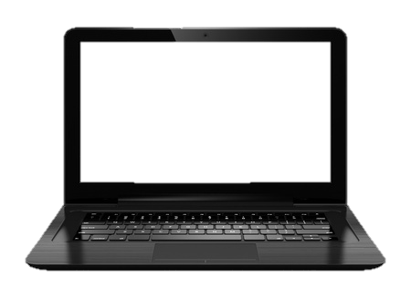
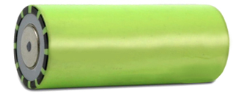
ABSORPTION
Storage and its controls absorb variations in supply
Stable energy supply
Time of Power Generation
www.transenergy.com

Slide 4
HOW IT WORKS
Peak and off-peak rates vs. current rate
Home Dynamic Load Profile - kW
Peak hour rate
Cost per kWh
Current rate
Off-Peak hour rate
A majority of household power demand occurs during the hours of 8 am to 9 pm
www.transenergy.com

Slide 5
HOW IT WORKS
Peak and off-peak rate vs. current rate
Solar peak hours
Blackouts
Peak hour rate
Cost per kWh
Off-Peak hour rate
Most solar power generation occurs between 10 am to 2 pm
Brown-outs and rolling black-outs often appear during peak hours because of high demand loading on the grid
www.transenergy.com

Slide 6
HOW IT WORKS
Solar power generation matched to daytime needs
PV Solar Power Generation
Peak hour rate
Cost per kWh
Off-Peak hour rate
PV solar systems generate power to meet household needs, and eliminates the risk of brown-outs
www.transenergy.com

Slide 7
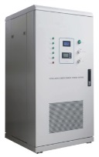
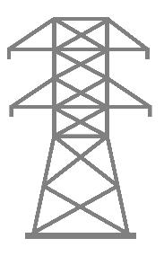
HOW IT WORKS
Collect it. Store it. Use it.
Oversize PV System to generate extra power and to collect and store it for later use
Peak hour rate
Cost per kWh
Off-Peak hour rate
PV solar systems can be oversized to feed in power to the grid for net metering or to charge energy storage systems
Storage systems provide independence from rising costs and increasing gird
instability
www.transenergy.com
Notes:
Oversize PV Power Generation will fade after 3.5 seconds during your talk. Then, you have to click for the storage and grid

